Slide 1
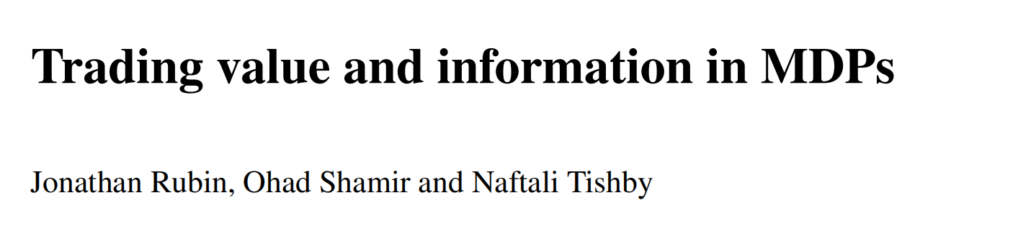
4/10/2026

Slide 2
Main Ideas
Standard MDP = maximize sequential decision making reward
Decision making in information theory framework:
Communication Cost
Tradeoff between expected reward (value) and control information
More: regularization

Slide 3
Standard MDP Setup
states
actions
rewards
transition probabilities
a stationary policy
Goal
narrow the setting to the stochastic shortest path

Slide 4
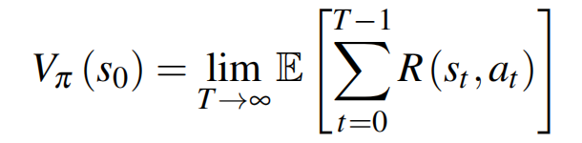
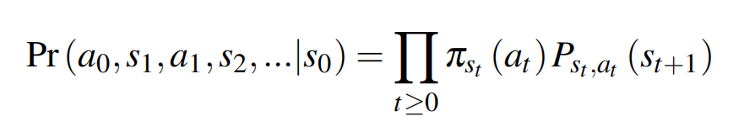
Setup (2)
Value function of policy 𝜋
the probability of a whole trajectory under policy 𝜋

Slide 5
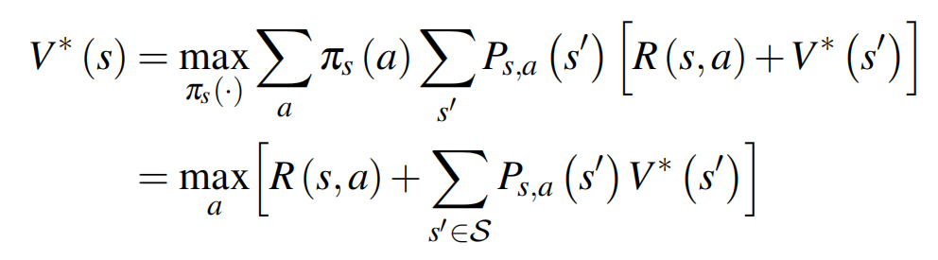
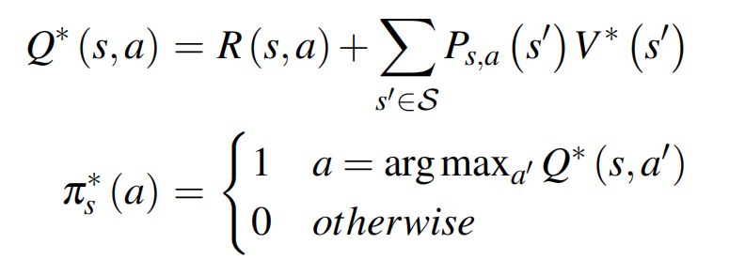
Setup (3)
Optimal Value function
Optimal states-actions value function & optimal policy

Slide 6
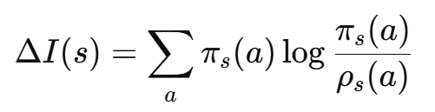

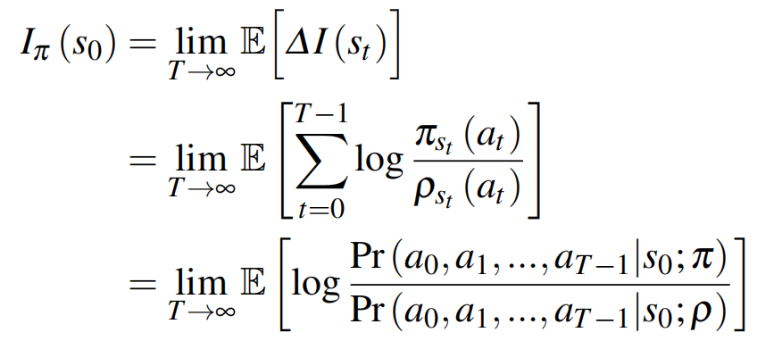
Next, introduce Control Information
one-step control information cost at state 𝑠(KL divergence)
assume is uniform over actions
total control information

Slide 7
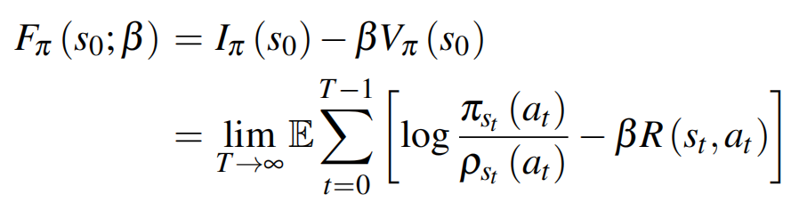
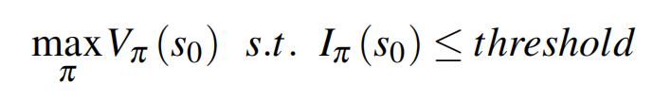
Free Energy Formulation
free energy formulation function
minimization → constrained optimization problem

Slide 8
Recall: Rate-distortion Theory
Trade-off for:
Rate: The average number of bits per symbol used to describe the source information.
Distortion: A measure of the discrepancy between the original source and its reconstructed representation.
Convexity
Stochastic Nature
→ Control Information as Bit Rate & Optimal Planning

Slide 9
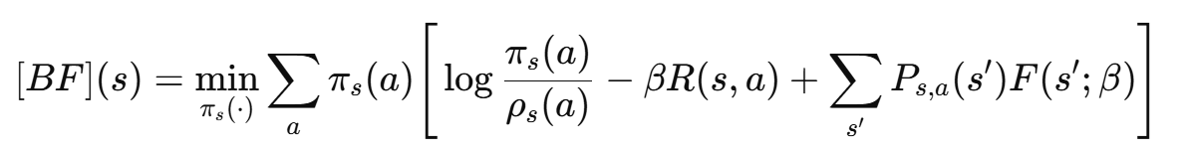

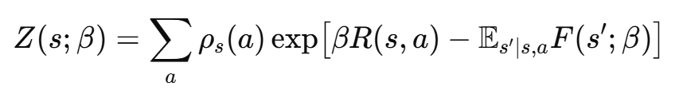
Bellman’s optimality equation
Unique fixed point → closed-form solution

Slide 10
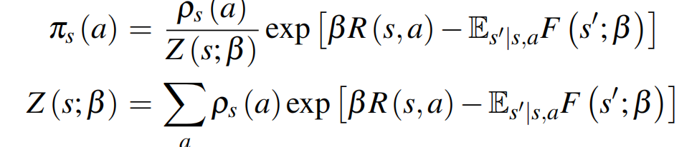

Closed-form solution
Iterative method with update

Slide 11
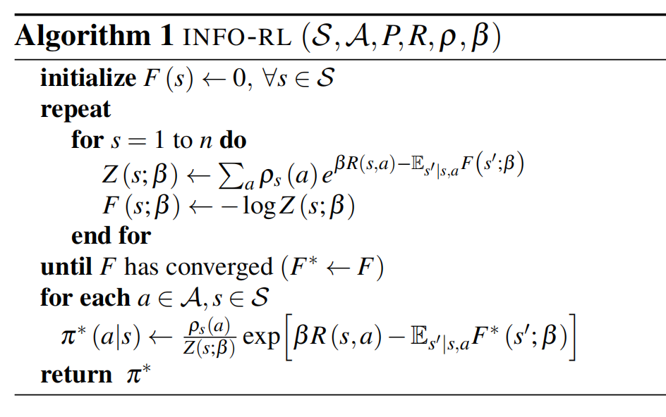
INFO-RL algorithm
the optimal solutions are naturally
stochastic policies

Slide 12
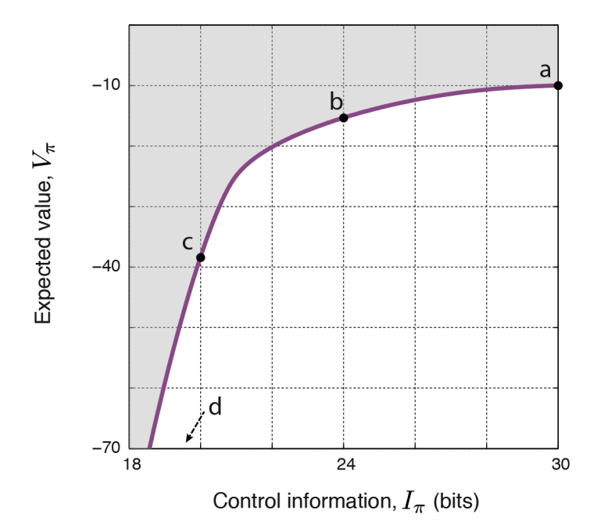
Value-information Curve

Slide 13
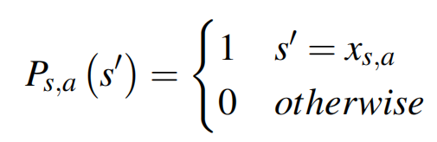

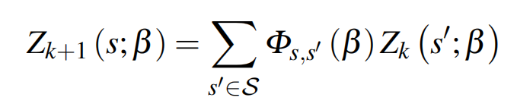

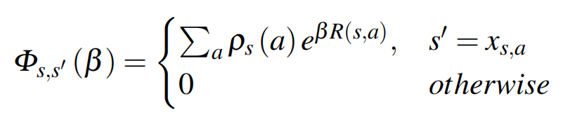
Special case: deterministic environment

Slide 14
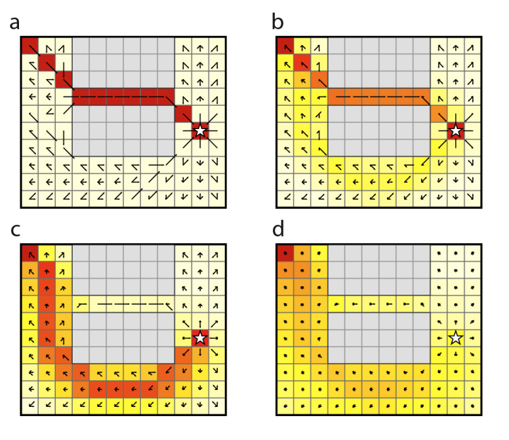
Grid World Example

Slide 15
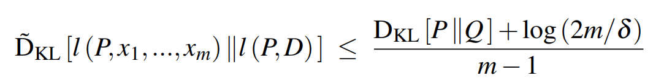
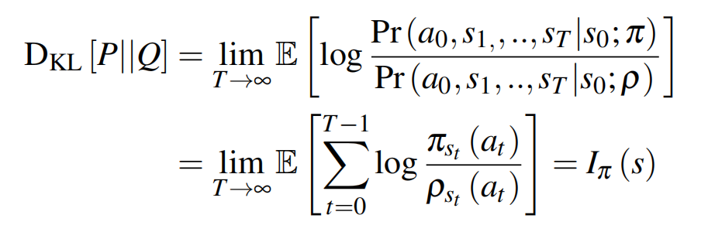
Regulation
PAC-bayesian approach
apply to the setting, we get

Slide 16
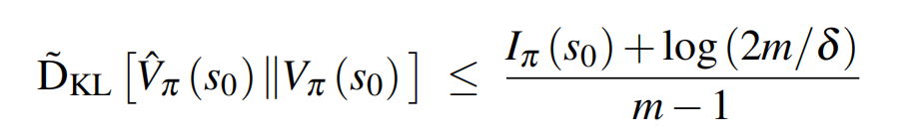
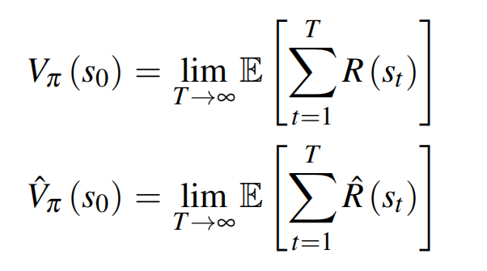
Regulation (2)
The bound for our setting

Slide 17
Discussion

